Slide 1


An Industrial Training Presentation
Prepared By: Guided By:
Purva Galani (20203103510349) Dr. Rachana Patel
B.Tech. (8th Semester) (CE) Assistant Professor (CE)
CGPIT. CGPIT.

Slide 2
Outline
2
Company Profile
Timeline Chart
Training Work
Project Introduction
Project Objective
Technologies/Platform
Modules of Project
Screenshot of work during training
Future work
Reference

Slide 3
Company Profile
Name: Sprier Technology Consultancy
At SPRIERS, we believe in creating solutions that matter. Our team of dedicated professionals works tirelessly to bring your vision to life, ensuring every project is handled with precision, creativity, and care.
Technologies:
Next.js, Node js , Express js, MongoDb, Cloud services, UI-UX.
Address :
Shop No. G-26, GREEN PALLADIA, opp. RAJ WORLD SHOPPING CENTER, nr. RAJHANS ORANGE, Palanpur, Surat, Gujarat 395009
Services:
Cloud Computing
Web Development
App Development
Saas Development
Cloud & Devops

Slide 4



Timeline Chart
ACTIVITY | 23 DEC - 25 DEC | 26 DEC- 31 DEC | 1 JAN- 7JAN | 8 JAN-28 JAN | 1 FEB-7 FEB | 10 FEB-..
Requirement Analysis
Designing
Implementation
Testing
Hosting

Slide 5
Training Work(Next Js)
What is Next.js?
Next.js is a React framework for building full-stack web applications.
Next.js. for additional features and optimizations.
Whether you’re an individual developer or part of a large team, Next js can help you build interactive,dynamic and fast React applications .

Slide 6
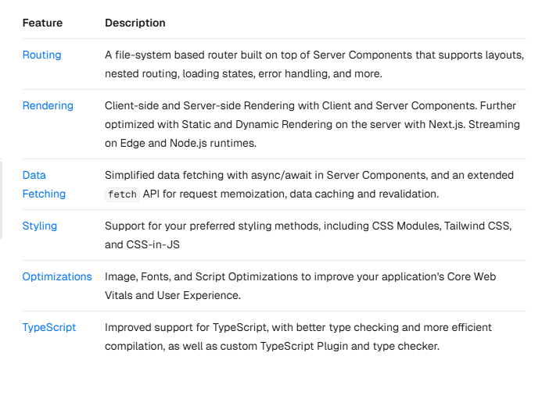
Training Work(Next Js)
Main Features :

Slide 7
Project Introduction
Our live project is a Customer Relationship Management (CRM) System built using Next.js, aimed at helping businesses manage their customer interactions, sales pipelines, and internal workflows more effectively.
The project focuses on delivering a fast, responsive, and secure web application that provides real-time data management, enhances productivity, and improves customer engagement.
As part of the development team, My primary contribution involved designing and developing the notification and reminder functionalities, ensuring seamless user experience and real-time updates.as wll as user authentication/security.

Slide 8
Project Objective
The primary objective of this CRM project is to develop a robust, scalable, and user-friendly system that helps businesses optimize their customer management processes and improve operational efficiency.
Improve customer relationships and communication.
Increase customer retention and satisfaction.
Centralize and organize customer data.
Automate tasks to boost productivity.
Streamline sales processes and track leads.
Integrate with existing business tools.

Slide 9
Technology
Frontend: Next.js, HTML/CSS , Material ui
Backend: Node Js,Express
Database: MongoDB
Authentication: Passport.js, JWT
Cloud Hosting: AWS
Version Control: Git, GitHub
Testing:Postman
Other Tools & Libraries : Socket.IO, Axios

Slide 10
Modules
Signin/signup
Dashboard
Add Lead
Add Invoice
Contact
Complaint
Google Login
charts
profile
reminder/notification
task

Slide 11
About Internship Area
Domain | Web Development Internship
Duration of Internship | Starting Date | Ending Date
 | 23-12-2024 | 22-05-2025
Mode of Internship (Online/Offline) | Offline
Live Project (Yes/No) | Yes
Working in Team/Individual | Yes, Working in Team

Slide 12
Learning Outcome (Week 1 & 2)
1. Real-time notification And scheduling Reminder:
I worked on implementing real-time notifications and reminders using Socket.io for WebSocket-based communication and Node.js Cron Jobs for scheduling tasksTask 1: Setting up WebSocket using Socket.io
Task 1: Setting up WebSocket using Socket.io
Integrated Socket.io into the project for real-time communication.
Established a WebSocket connection between the client and server.
Handled connection, disconnection, and event-based messaging.
Implemented an event-based notification system to broadcast updates.
Task 2: Implementing Notifications System
Designed a structure to store and manage notifications in the database.
Created APIs to send, retrieve, and mark notifications as read/unread.
Used Socket.io to push real-time notification to users.
Task 3: Setting up Cron Jobs for Reminders
Integrated node-cron to schedule periodic tasks.
Created a cron job to send reminders at specific times.
Ensured reminders trigger at scheduled intervals by fetching data from the database.
Logged and monitored scheduled jobs for debugging and performance tracking.

Slide 13
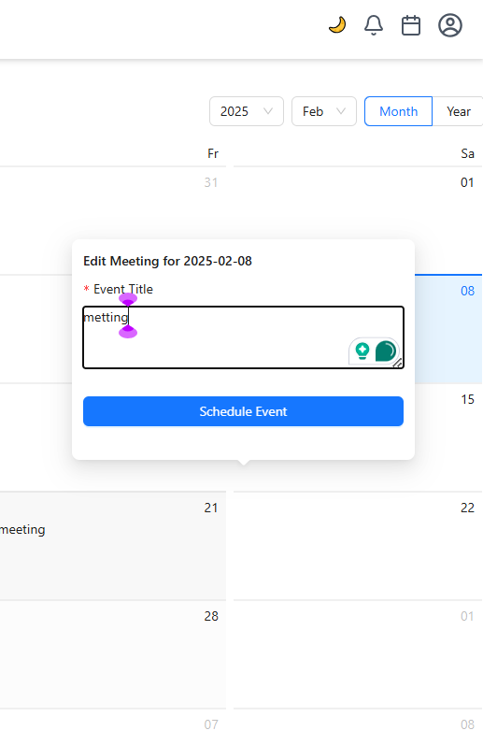
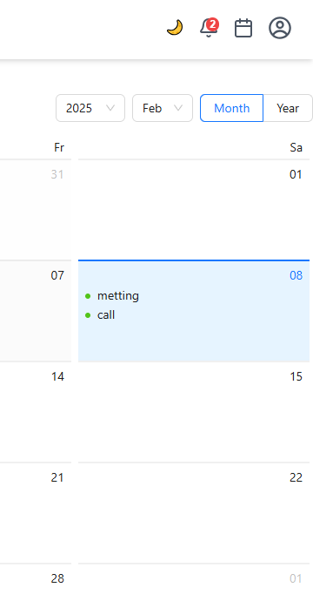
1.1 Add reminder notes in calender
1.2 reminder notes in calender and notification

Slide 14
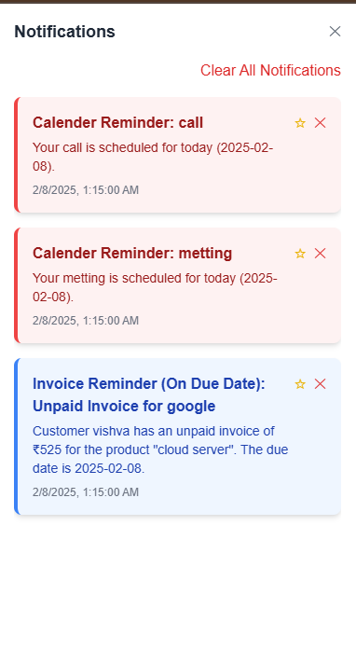
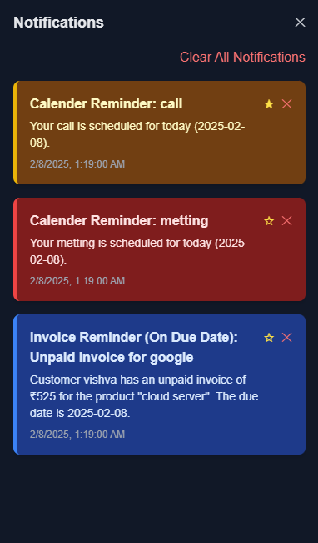
1.3 notification panel
1.4 notification panel dark mode

Slide 15
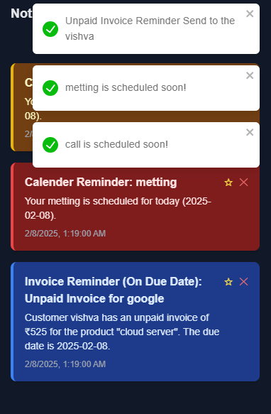


1.4 toast notification
1.5 notification count
1.4 toast notification

Slide 16
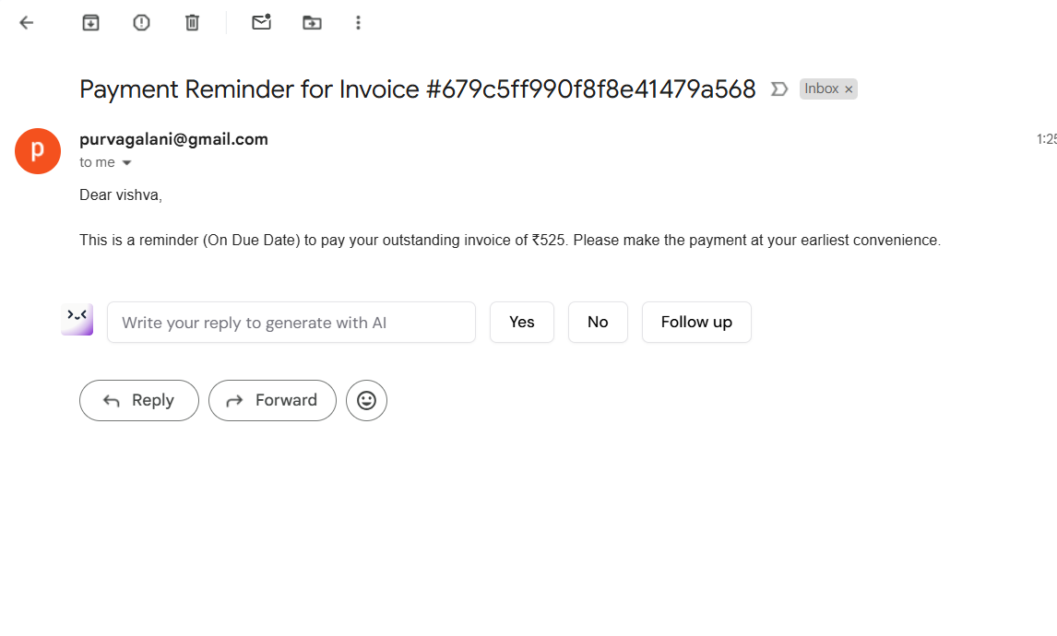
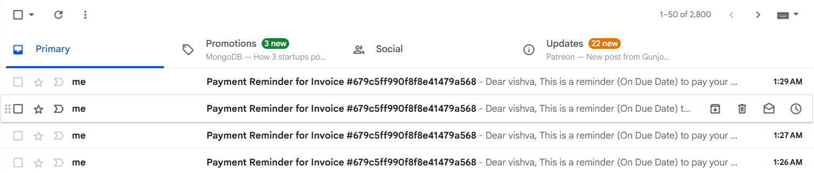
1.6 reminder to email

Slide 17
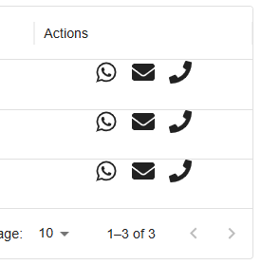
Learning Outcome (Week 3 & 4)
2. Communication Features:
Integrated functionality for sending messages via WhatsApp, initiating calls, and sending emails.
Enabled message editing functionality, allowing users to modify existing messages.
Ensured that updated messages are successfully stored and reflected in the database.
2.1 mail, whatsup, call button

Slide 18
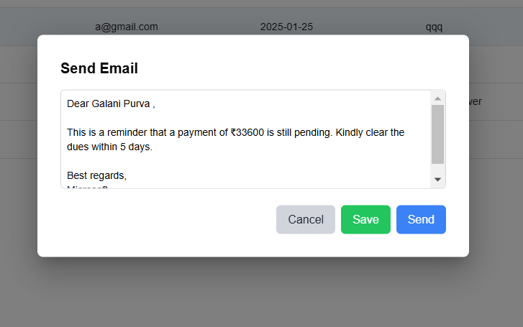
2.1 mail, whatsup, call button
2.2 send mail

Slide 19
1.4 toast notification
2.3 reminder to email and send mail

Slide 20
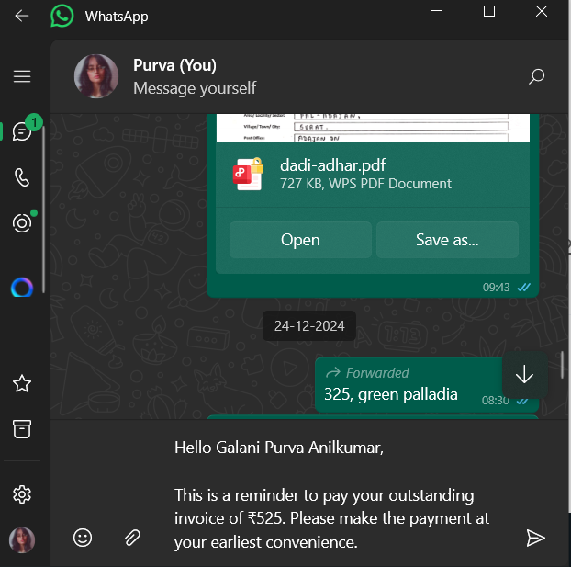
2.3 send whatsup msg

Slide 21
Learning Outcome (Week 5 & 6)
3. user Authentication :
Implemented Google Authentication in the Next.js application using Passport.js to enable secure and seamless user login. Configured OAuth 2.0 credentials through the Google Developer Console and integrated Passport’s Google Strategy for authentication. Managed user sessions efficiently with JWT (JSON Web Tokens) to ensure secure data handling. This approach enhances security, simplifies the login process, and improves the overall user experience.
Implemented a Login-Signup panel with robust verification and authentication using Next.js for the frontend and Node.js for the backend. The system ensures secure user registration and login, incorporating features like email verification and password encryption to enhance security. Authentication is managed using JWT (JSON Web Tokens) for secure session handling, while proper validation mechanisms are in place to prevent unauthorized access. This implementation provides a seamless and secure user experience, ensuring data integrity and protection.

Slide 22
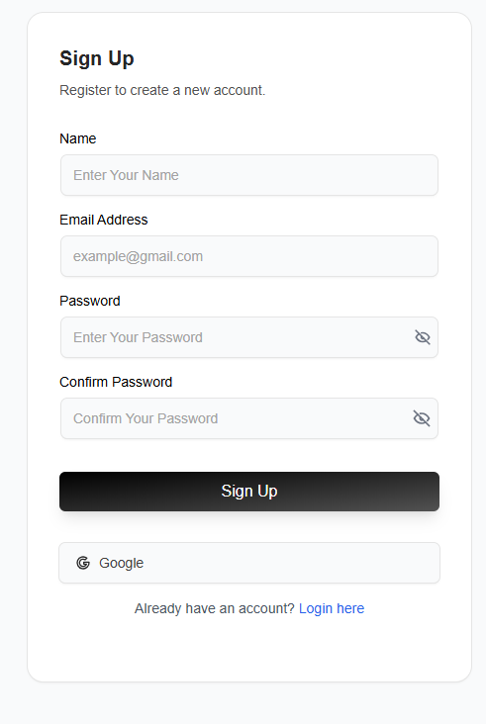
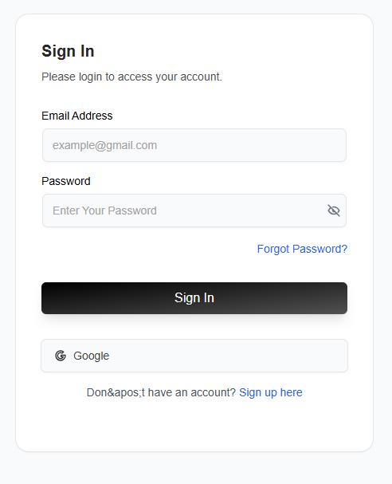
2.3 send whatsup msg
3.1 and 3.2 sign in and sign up

Slide 23
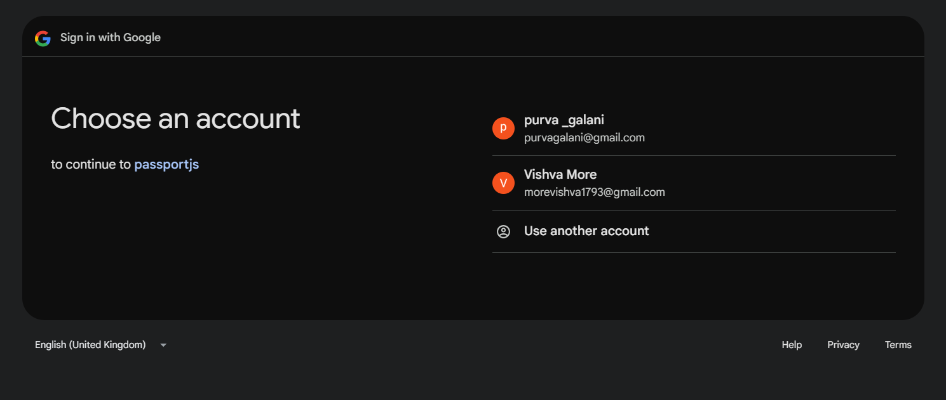
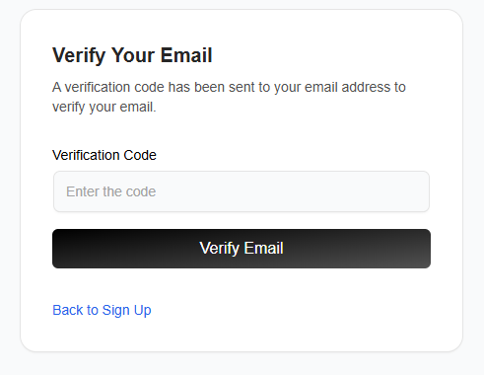
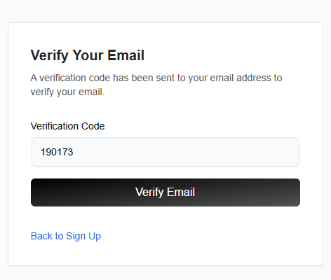
3.1 and 3.2 sign in and sign up
3.3 sign in with google
3.4 verifiy email

Slide 24
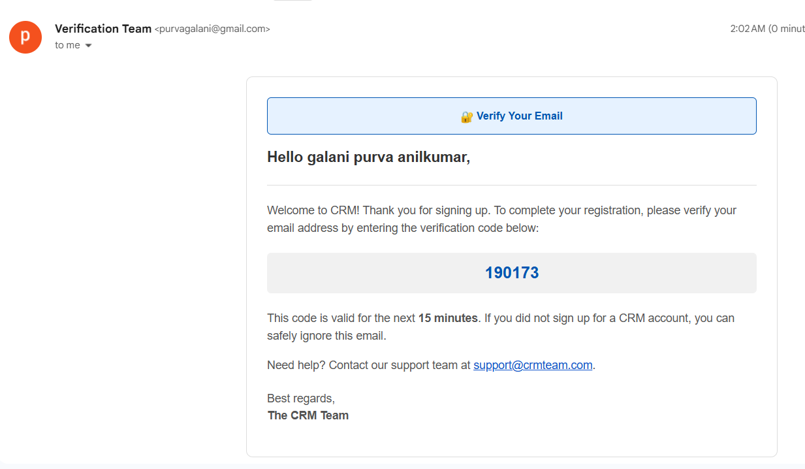
3.5 verifiy email code to email

Slide 25
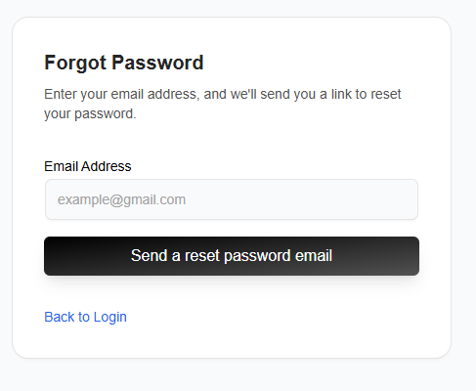
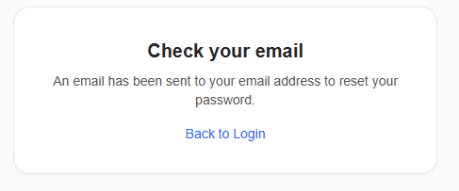
3.6 forgot password

Slide 26
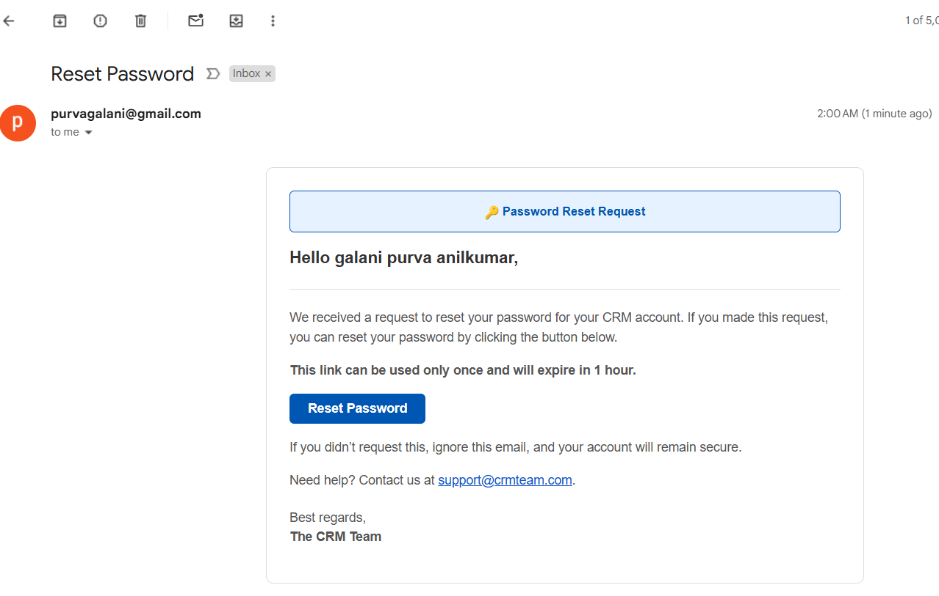
3.7 forgot password email

Slide 27
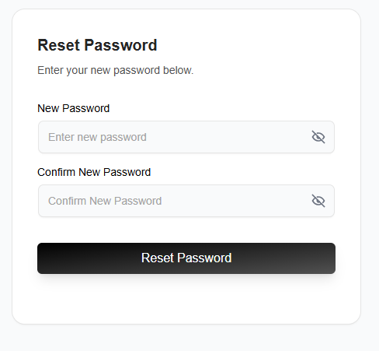
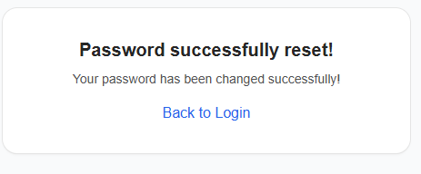
3.8 rest password

Slide 28
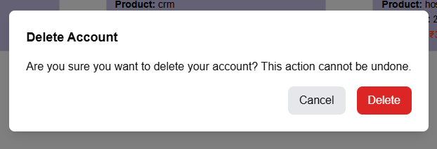
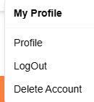
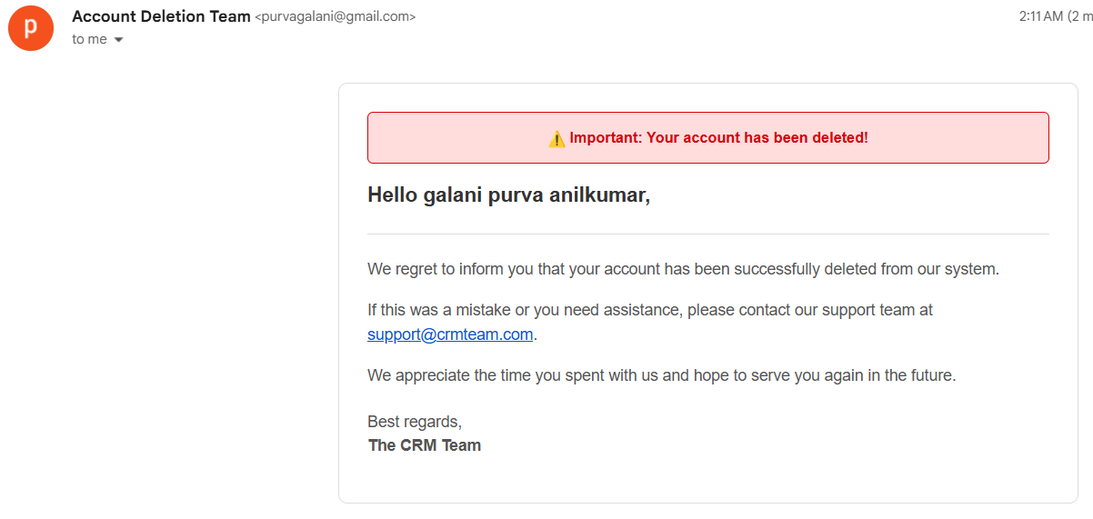
3.9 delete account and
log out

Slide 29
Conclusion
In my internship i learnt that how to work with industry with new technology. how to communicate with team members .Develop my leadership and time management skill . I was working with React JS. During this span i become very punctual to my team and company members. Really, It was nice experience for me.

Slide 30
Thank You

